Slide 1
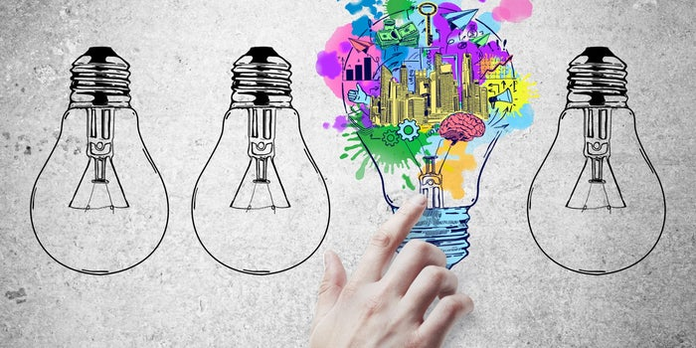
Innovation
A novelty with meaningfulness

Slide 2
Novelty and Meaningfulness
Novelty
Relatively new to the environment and to the users
Meaningfulness
Whether it will be used by public on a large scale
Do they need it? (wants/needs/irritations)

Slide 3
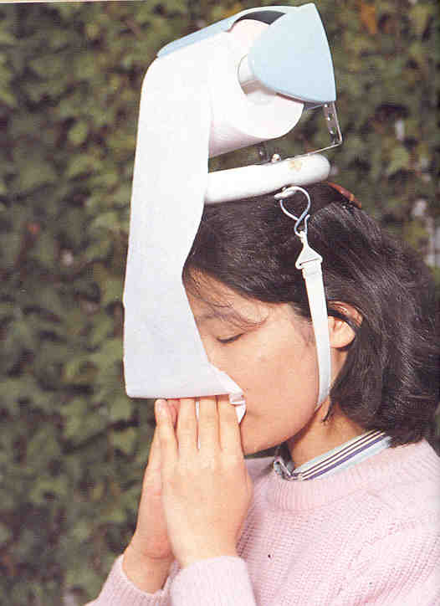
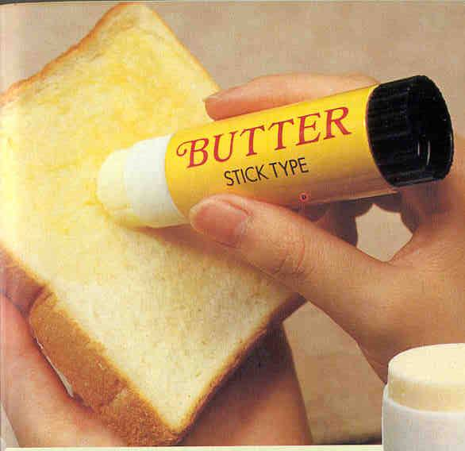
Novel? Meaningful?

Slide 4
Types of Innovation
Radical
Incremental
Flash of a genius
Radical shift
Rare and difficult
Builds upon existing knowledge
Small changes in current system
Common and easy
Notes:
Novelty needs thinking capability however radical innovation does not demand it.
Incremental innovation is possible if you know the system in detail while radical innovation does not need this.

Slide 5
Types of Innovation
Fridge (radical shift for society to preserver things) → new models with smaller increments every days, like with new cooling systems, better air flow algorithms etc
LED Bulbs (Radical Shift in luminosity) → Reducing energy consumption of LEDs (incremental)
GPS (Radical shift in navigational systems)→ Increasing accuracy with new algorithms (increments)
Notes:
Novelty needs thinking capability however radical innovation does not demand it.
Incremental innovation is possible if you know the system in detail while radical innovation does not need this.

Slide 6
Some Innovations
Pocket cinema
Projector of size of soda can
Wireless speakers
Change of package color if food expires
Smart Glasses
Find my glasses
Turn to sun glasses
Wireless charging

Slide 7
Innovation in different contexts
As an object/idea: an object which is novel and meaningful
As a process: the process with which we generate a novel and meaningful idea, which in turn is translated into a novel and meaningful product, which in turn creates value for the customer
Same word used for both, the object and the process

Slide 8
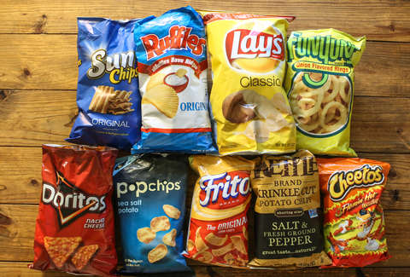
An Innovation?
Notes:
Is it innovative to have different brands of chips which are prepared in almost same manner ? (NO)

Slide 9
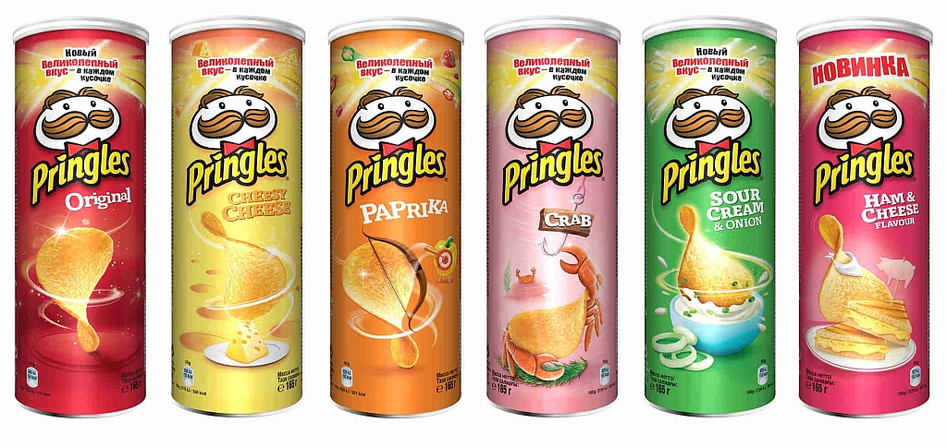
An Innovation?
Notes:
Are pringles prepared the same way as other chips? (NO)
This is innovative. It is prepared through a mixture of mashed potatoes which are then compressed in a heated environment. So, they are prepared differently and thus differ in taste.
even if their preparation is not innovative, their packaging is a very meaningful innovation

Slide 10

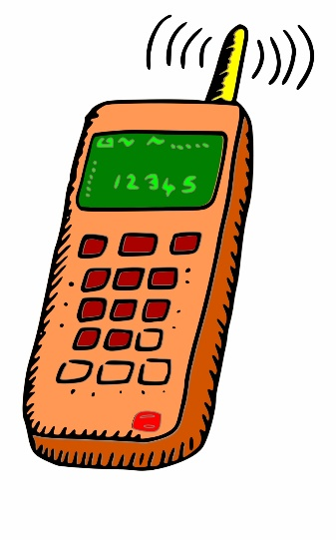

Time saving? Efficient? Organized?
What Type of Innovation it this?
Notes:
PAST : For communication, postmen delivered mails at post office and you got them in your post boxes outside your home
NOW: Communication is fast and real-time due to E-mails and Mobo phones

Slide 11




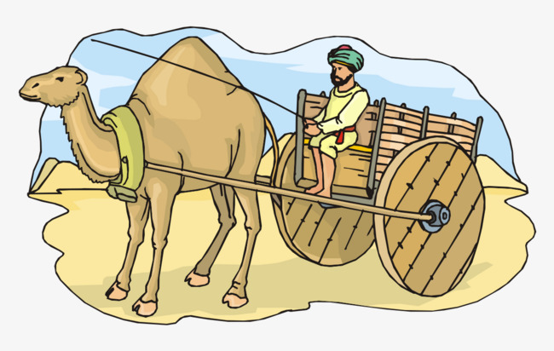
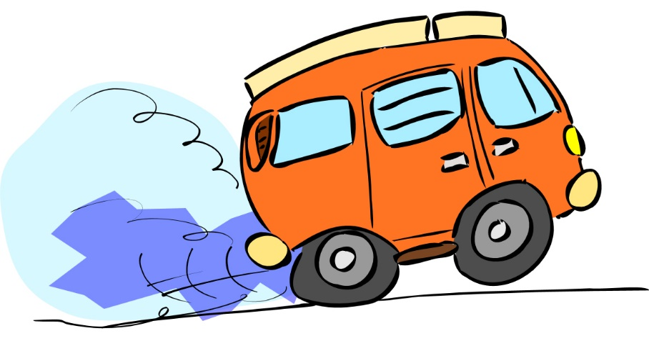

What Type of Innovation it this?
Notes:
Travel Past: People had to walk to their destination [Took months and years]
2nd Phase: Human developed a mode of transportation through animal carts
3rd phase: Cars were designed
4th phase: We got air planes to travel to other corners of the world within very less time

Slide 12


What Type of Innovation it this?
Notes:
Past: Documentation was done on papers [unorganized, hard to retrieve data, hard to manage and save, time-taking, effortful , needed space to save info] Present: We have computers and laptops to save data in an organized manner. We can retrieve data anytime and it does not take any physical space. We can have backups

Slide 13
Incremental Innovation Example
Toyota is a great example of evolutionary innovation in practice.
They are not attempting to reinvent the car or create a product that will disrupt the entire car market.
Instead, Toyota focuses on building better cars for already existing markets.

Slide 14
Incremental Innovation Example
Introduction of Touch devices (radical Shift) followed by increments delivered almost everyday
Introduction of Laptops (radical Shift) followed by increments delivered almost everyday

Slide 15
Why innovate?
Why should we innovate?
What can be the outcome?
I need some motivational things here, to prepare them to find innovative ideas for their final year project
Please contribute to this slide

